Slide 1


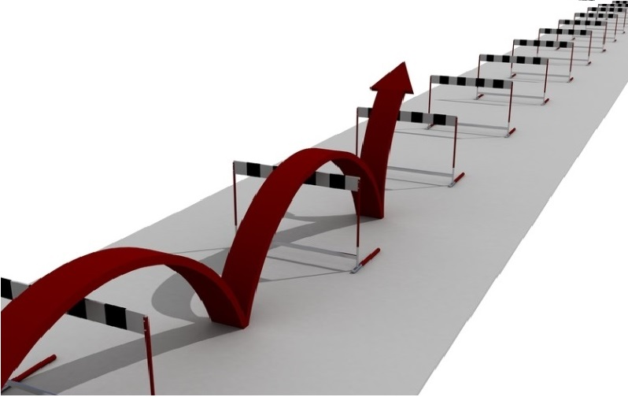







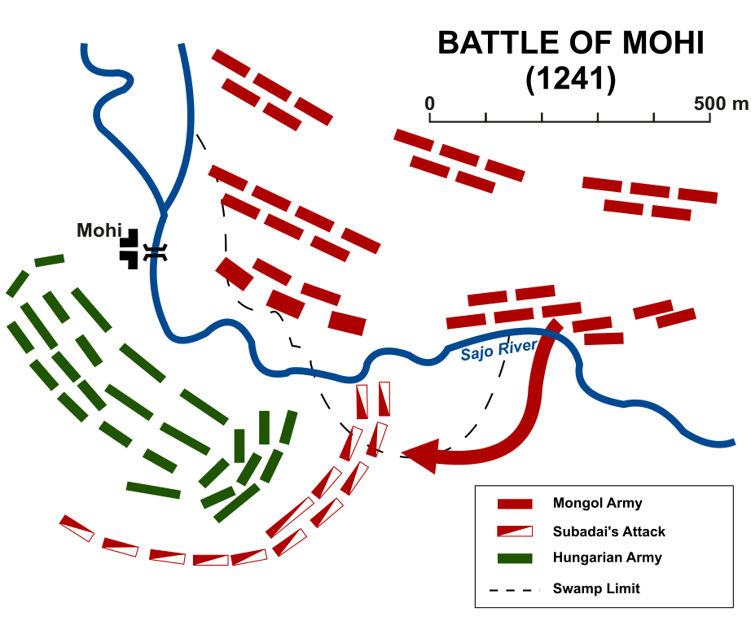
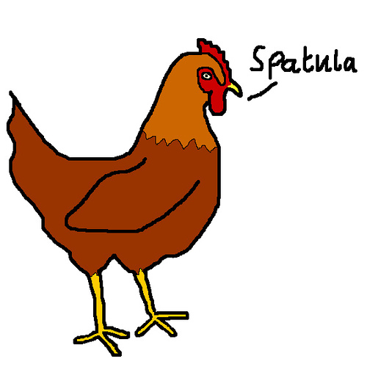



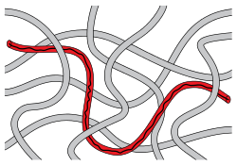

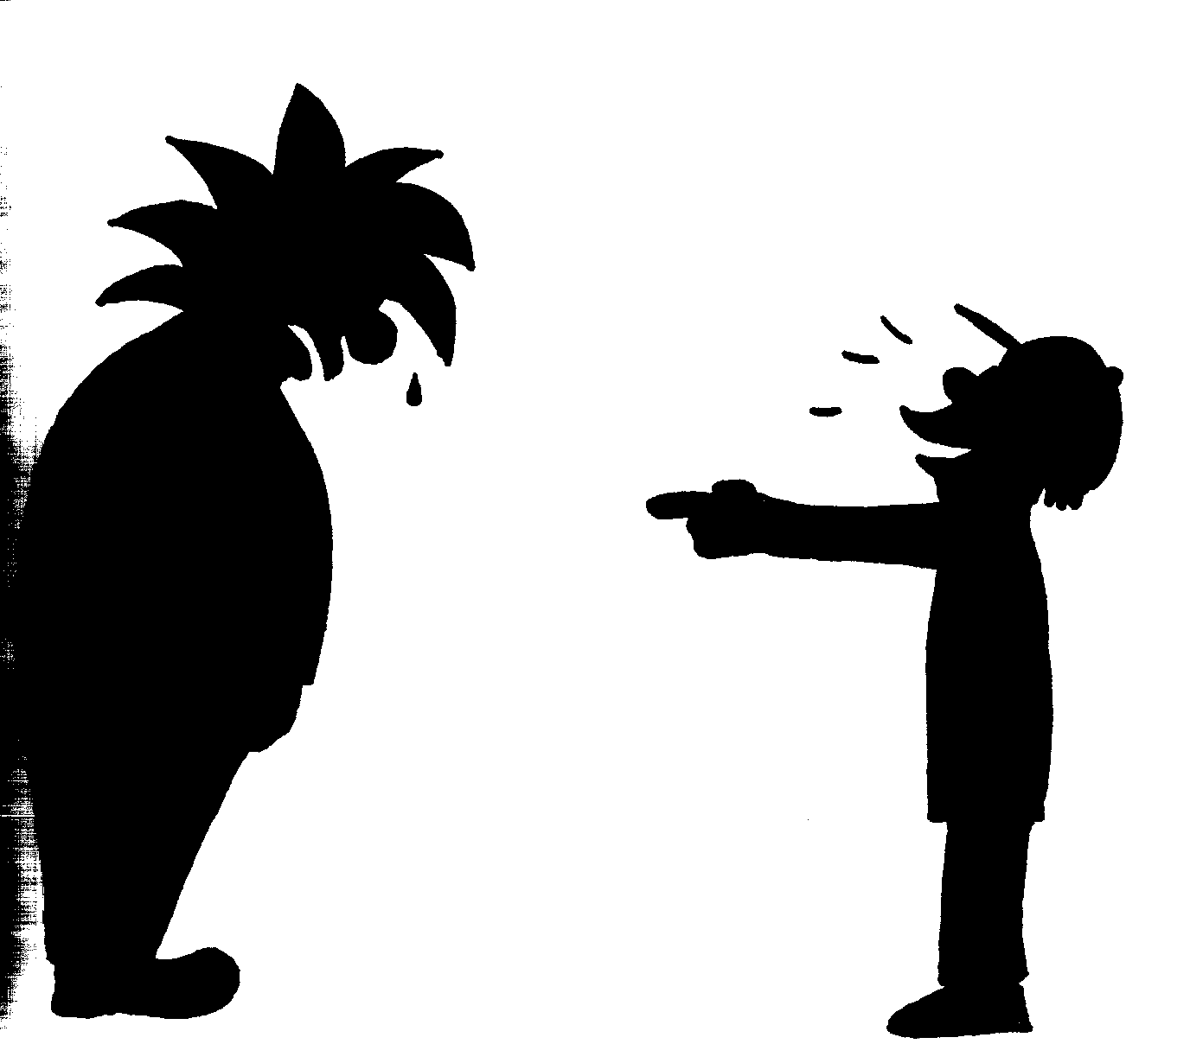
Ender’s Game Vocabulary: Chapters 7 and 8
comparative: relative, how something seems when compared to another
confiscated: taken away with authority
consequences: a result or effect of an action or condition
deliberately: on purpose
efficiency: an action designed to achieve without waste
entangled: to become twisted together or caught up in
grossly: something done in an extreme or excessive way
haphazardly: something done without order or planning
insubstantial: lacking strength or solidity
maneuvers: movement or series of moves requiring skill
methodically: something done in detail and a precise manner
obscurity: being unknown or unimportant
obstacles: something that blocks the way or hinders progress
perception: the state of being aware through the senses
precision: the quality of being exact and accurate
random: chosen without method or conscious decision
rebound: bounce back after hitting a surface or object
ridiculed: making fun of something or someone in a cruel way

Slide 2
Chapter 7 Summary
Chpt 7: Ender is transferred to Salamander Army. Before he goes, he plays a gory playground game on his desk and is repeatedly killed. At his new dorm, the only girl in the group, Petra, befriends him and teaches him how to shoot each morning. The commander of the group, Bonzo, dislikes him and won’t let him play in the battle games. Ender obeys Bonzo’s misguided orders during the games, although he (Ender) knows how to save his army. Ender practices with some Launchies and shows them the moves he’s learned. During the next game, he disobeys Bonzo and shoots the enemy, thus making the battle a draw. He is traded out of Salamander to Rat Army.

Slide 3
Chapter 7 Study Guide Questions
Study Guide Questions:
Where has Ender been transferred? Salamander Army
What does Alai whisper to Ender? “Salaam”
What do the children at the playground game turn into? wolves
Why can’t Ender palm his locker open at Salamander? It’s not locked; nothing is private
Who volunteers to show Ender how to shoot? Petra Arkanian, the only girl in Salamander
Why does Ender think that adults at the school are the enemy? They have not told the truth about controlling gravity.
Why does Ender get the Launchies to practice with him? No one else will practice with him.
Who does Ender tell about his birthday? No one
Why did Ender go to Battle School? So Valentine would be safe from buggers.
What four things has Ender learned about battles from Salamander? He learned that the enemy’s gate is down, to use his legs as a shield, a small reserve used at the end of a game can be important, and sometimes soldiers can make smarter decisions than their leaders.
Where are the things Ender values? In the school computer and in his head and hands
For what course does Ender register? Earth-gravity personal combat

Slide 4
Chapter 8 Summary
Chpt 8: Ender’s new army is disorderly. He’s placed in Dink’s toon, and Dink puts doubts in Ender’s mind about what is truth and what is not. Dink doesn’t trust adults. Ender’s techniques are adopted by his army after he shows them how to attack the enemy. Rumors circulate that the Launchies practicing with Ender will not be chosen as good soldiers. Some older boys fight Ender’s practice group, and the younger boys win. Ender injures four boys, and he once again hates himself for hurting others just to save himself. He plays the fantasy desk game again, and this time sees Peter in a mirror reflection of himself. Ender is not sorry when he dies in the fantasy game.

Slide 5
Chapter 8 Study Guide Questions
Study Guide Questions:
Why doesn’t Dink correct his toon members when they say they don’t like Ender’s method of attack? He doesn’t understand how it actually works.
Who watches Ender’s first night practice after he joins the Rats? Petra and Dink
What is the first battle order Rose gives Ender? To lead the troops through the door and go straight toward the enemy’s door.
Who does Dink say is the enemy? The teachers
What scare tactics are used on some of the Launchies who practice with Ender? Some are slapped around, their files are trashed, or they have accidents in the game room or mess hall.
Who starts the fight in the practice room? How does it start? Ender and Alai; they throw a frozen soldier at one of the older boys.
How are the older boys’ injuries listed in the medical report? Accidental Collision in Null G
How many boys show up for Ender’s practice the night after the fight? 45
What is Ender’s worst fear? That he is a killer.

Slide 6
Prediction Question Chapter 7-8
(Due 11/09 – Weds)
Prediction Question 4 (Chpt 7): Would an army be successful under Ender’s command?
Prediction Question 5 (Chpt 8): How was the mind game able to place Valentine and Peter in the programming? Will the IF let Ender keep playing it, or will Anderson erase the game?

Slide 7
Prediction Question Chapter 5-8
3. 5-6: Will Alai become one of Ender’s allies?
4. 7: Would an army be successful under Ender’s command?
5. 8: How were Val and Peter placed in the mind game? Will the IF let Ender keep playing it?
Chapter/Pages | CHARACTERS | CONFLICT | PREDICTION | WHY? | CORRECT?
Chpt 5-6 69-98 | Anderson Dap Alai Shen Bean Bernard | Ender v Launch Group/Older Boys in gameroom (CvS) Ender v Bernard (CvC) | Alai will/will not become one of Ender’s allies. | I predict this because…
Chpt 7 99-131 | Bonzo Petra | Ender v Bonzo (CvC) | An army will/will not be successful under Ender. | I predict this because…
Chpt 8 132-154 | Dink | Ender v Older boys (CvS) Ender v IF Authorities (CvS) | I predict Val and Peter were put in the mind game by …; and that the IF will/will not allow him to keep playing it. | I predict this because…

Slide 8
Chapter 7-8 Story Map (Movie)
Alai shares a sacred religious phrase with Ender, “salaam”, showing his love and respect for him.
In his first Salamander battle, Ender disobeys direct order to stay inside the gate and not draw his weapon.
Ender is transferred/promoted to Salamander Army under Bonzo Madrid.
Bonzo confronts Ender in the sparring room and threatens him.
Bonzo makes it obvious he is not happy with the addition to his army and forces Ender to sit out of practices and battles.
Ender returns to the mind game and finds Valentine.
Petra offers to train Ender to shoot.
Valentine runs away and Ender follows her to a castle where he defeats a snake.
Bonzo tries to order the extra practices to stop, but Ender threatens to get Bonzo iced if he interferes with his free play activities.
After defeating the snake, Peter appears in a mirror and tells Ender he is a killer now.

Slide 9
Character Attribute Web: Chapters 7-8 (Movie)
f
What Ender thinks:
What Ender says:
What Ender does:
Ender thinks Bonzo making stupid decisions and giving irrational commands will affect the respect his army has for him.
“If you try to control my free play, I’ll have you iced.” (to Bonzo)
Ender disobeys the direct order from Bonzo to stay out of the battle when he sees Salamander is loosing and Petra is hurt.
Environment (School/Home/Battle School):
What others do to Ender:
Ender is kept from achieving his true potential by not being allowed to participate in his army’s battles and practices under Bonzo’s command.
Alai tells Ender “salaam” when he is transferred to Salamander Army.
Bonzo forces Ender to sit out of practice and battles, and tries to limit Ender’s free play activities.
Bonzo corners Ender in the sparring room and threatens him.
Andrew Wiggin
“Ender”
.
Authority interaction or inaction and how it affects Ender’s decisions:
Other conflicts that affect Ender:
Graff has Ender transferred to Salamander Army after he kills the giant just as he is beginning to gain the other Launchies’ respect.
When Ender returns to the mind game, both Valentine and Peter are there this time. Peter appears after Ender defeats a snake and tells him he is a murderer now.
.
.
.

Slide 10
Chapter 7-8 Media Compare and Contrast
Practice w/Launchies: 02:11:14 – 02:13:13 (2min – pg 119 to 120)
We pick up in the book after Alai shares the phrase “salaam” with Ender as he leaves for Salamander. Bonzo makes it clear he does not want Ender in his army and he is expected to sit out of all practices and battles until he can be traded. Petra offers and takes Ender to teach him how to shoot, aim, and use his laser properly.

Slide 11
Chapter 7 Media Compare and Contrast
Practice w/Launchies: 02:11:14 – 02:13:13 (2min – pg 119 to 120)
In the movie, Bonzo is angry Ender is practicing with Petra. In the book, Petra teaches Ender how to shoot, but Ender is spending his extra practice with his launch group too. Think about how the addition of the launch group practices helps form the relationships between Ender, Alai, and the rest of the launch group.
Discussion: How does offering to teach the launch group the moves he learns from the older soldiers in Salamander make Ender a good commander?
1st: It makes him a good commander because he sees utilizing all his soldiers helps him to improve as well.
2nd: He teaches the other launchies new moves, and good commanders show their soldiers how to improve. He and the Launchies try new maneuvers and tactics that the older soldiers wouldn’t dare to try. He introduced the Launchies to maneuvers and tactics they would not get to experience until they had made it into an army.
5th: He shows he is a good commander by teaching the other soldiers how to strategize. He takes his time to learn new things and does not go straight for his enemy unprepared unlike Bonzo.
7th: Prepares the other soldiers for battles, he shares with them the best techniques he knows, guides them into learning new commands – He shares his knowledge gained with his soldiers so everyone is as prepared as possible to face the enemy.

Slide 12
Chapter 7 Media Compare and Contrast
Practice w/Launchies: 02:11:14 – 02:13:13 (2min – pg 119 to 120)
CAW/SM: Ender invites his old launch army to practice with him. Bonzo tells Ender he cannot practice with Launchies. Ender threatens to get Bonzo iced if he interferes with his free play.
What information on your character attribute web and story map needs to be changed to include the differences between the book and the movie?

Slide 13
Chapter 7 Story Map (Book)
Alai shares a sacred religious phrase with Ender, “salaam”, showing his love and respect for him.
Ender is transferred/promoted to Salamander Army under Bonzo Madrid.
Bonzo makes it obvious he is not happy with the addition to his army and forces Ender to sit out of practices and battles.
Petra offers to train Ender to shoot, and Ender begins practicing with launch group.
Bonzo tries to order the extra practices to stop, but Ender threatens to get Bonzo iced if he interferes with his free play activities.

Slide 14
Character Attribute Web: Chapters 7-8
f
What Ender thinks:
What Ender says:
What Ender does:
Ender thinks Bonzo making stupid decisions and giving irrational commands will affect the respect his army has for him.
“If you try to control my free play, I’ll have you iced.” (to Bonzo)
Ender offers to use free play to have extra practice with his launch group.
Ender disobeys the direct order from Bonzo to stay out of the battle when he sees Salamander is loosing and Petra is hurt.
Environment (School/Home/Battle School):
What others do to Ender:
Ender is kept from achieving his true potential by not being allowed to participate in his army’s battles and practices under Bonzo’s command.
Alai tells Ender “salaam” when he is transferred to Salamander Army.
Bonzo forces Ender to sit out of practice and battles, and tries to limit Ender’s free play activities.
Bonzo corners Ender in the sparring room and threatens him.
Andrew Wiggin
“Ender”
.
Authority interaction or inaction and how it affects Ender’s decisions:
Other conflicts that affect Ender:
Graff has Ender transferred to Salamander Army after he kills the giant just as he is beginning to gain the other Launchies’ respect.
When Ender returns to the mind game, both Valentine and Peter are there this time. Peter appears after Ender defeats a snake and tells him he is a murderer now.
.
.
.

Slide 15
Chapter 7 Media Compare and Contrast
Salamander v. Condor: 02:17:13 – 02:23:14 (6 min – pg 123 to 126)
In the movie, Ender disobeys Bonzo during his first battle. In the book, Ender obeys Bonzo’s order, even though he knows he could have saved their army from being defeated. In the mess hall, when questioned why he did not disobey orders and fire, Ender tells the other solders, “I obey orders.”
How do you think Bonzo and Enders’ actions affected the way the other soldiers view them?
Bonzo:
1st: Other commanders saw that Bonzo was making irrational orders that cost him and his army in the ranks.
2nd: They question his ability to command because he is making poor command choices in battles when it comes to his soldiers.
5th: The other commanders might have understood how Bonzo’s command caused the defeat of Salamander.
7th: The other commanders probably questioned Bonzo’s tactics and strategies since he had one active soldier remaining when his army was defeated by Condor.
Ender:
1st: The other commanders see that Ender obeys orders, even if he does not agree with them. This may make it easier for Ender to be transferred to another army.
2nd: They will respect him more for following orders.
5th: He will be respected more by the other commanders/soldiers for obeying orders.
7th: The other soldiers respected him more for following orders when they knew those orders could have been disobeyed and saved the army from being defeated.

Slide 16
Chapter 7 Story Map (Book)
Between Condor and Leopard: 02:23:14 – 02:26:15 (3 min – pg 127 to 128)
This portion of the text is only 1.5 pgs. However, it summarizes five important events/insights into things that affected Ender while at Battle School. Summarize these 5 events in a story map.
THINK: Why are these 5 events important to understanding who Ender is and how being at Battle School has changed him?

Slide 17
Chapter 7 Story Map (Book)
Between Condor and Leopard: 02:23:14 – 02:26:15
This portion of the text is only 1.5 pgs (3 min read). However, it summarizes five important events/insights into things that affected Ender while at Battle School. Summarize these 5 events in a story map.
A side effect of Ender sitting out of the battle was he came out on top of the “prized” efficiency list.
His practices with the Launchies gained interest because they were seeing results. Practices in the evening were the best time of day.
Ender turns 7, but no one in Battle School shares birthdays.
Ender continued to obey Bonzo’s ridiculous order for two additional battles.
The only reason Ender is at Battle School is to protect Valentine. He misses his family and wants to go home.
Keep this map separate from our main story map, but keep it with EG documents.

Slide 18
Chapter 7 Story Map (Book)
THINK: Why are these 5 events important to understanding who Ender is and how being at Battle School has changed him?
1st: (T) “I do care. The only reason I’m here is so that a bugger won’t shoot out Valentine’s eye …” (D) Trained with his launch group and learned new strategies because they were not afraid to try new tactics. (OC) Ended up efficiency list because he obeyed Bonzo. He also turned 7. (E) No one shares information about home or birthdays.
2nd: (T) Only reason he is at Battle School is to protect Valentine. (D) Uses what he learns from watching Salamander to train his launch group. (OC) Because he obeyed Bonzo, he ended up the leader of the efficiency list. Turned 7. (E) No one talks about home, nothing existed before Battle School.
5th: Sociogram Adj: Obedient, isolated/lonely
7th: (T) Bonzo has a good army even though he does not have good strategy. (D) Trains with Alai and launchies, learns new maneuvers no “self-respecting” soldier would try. (OC) Takes lead in efficiency list and turns 7. (E) Wants to tell Petra about his birthday, but no one talks about home at Battle School because it is childish.
*Categorize and record the information into your character attribute web:
What Ender Thinks
What Ender Does
Other Conflicts
Environment

Slide 19
Character Attribute Web: Chapters 7
f
What Ender thinks:
What Ender says:
What Ender does:
Ender thinks Bonzo making stupid decisions and giving irrational commands will affect the respect his army has for him.
Even though Bonzo has a weak grasp of strategy, Salamander was still one of the better armies.
Everyone pretends they do not care about home, but the only reason he is at Battle School is to protect Valentine from the buggers.
“If you try to control my free play, I’ll have you iced.” (to Bonzo)
Ender offers to use free play to have extra practice with his launch group.
Ender disobeys the direct order from Bonzo to stay out of the battle when he sees Salamander is loosing and Petra is hurt.
Trained with Alai to come up with new tactics and improve as a soldier, while finding a way to enjoy some of his time at Battle School.
Environment (School/Home/Battle School):
What others do to Ender:
Ender is kept from achieving his true potential by not being allowed to participate in his army’s battles and practices under Bonzo’s command.
Alai tells Ender “salaam” when he is transferred to Salamander Army.
Bonzo forces Ender to sit out of practice and battles, and tries to limit Ender’s free play activities.
Bonzo corners Ender in the sparring room and threatens him.
Andrew Wiggin
“Ender”
No one shares birthdays at the Battle School, it was childish. No one talked about home.
Authority interaction or inaction and how it affects Ender’s decisions:
Other conflicts that affect Ender:
Graff has Ender transferred to Salamander Army after he kills the giant just as he is beginning to gain the other Launchies’ respect.
When Ender returns to the mind game, both Valentine and Peter are there this time. Peter appears after Ender defeats a snake and tells him he is a murderer now.
Ender comes out as the leader on the prized efficiency list because he obeys Bonzo’s order to sit out of battle, causing some soldiers to be angry.
Ender turns 7.
.
.
.

Slide 20
Chapter 7 Media Compare and Contrast
Salamander v. Leopard: 02:26:15 – 02:31:35 (5.5 min – pg 128 to 131)
In the movie, Ender disobeyed Bonzo during his first battle. In the book, Ender obeys Bonzo’s order through 3 battles before disobeying him.
How might this change your perspective of Ender’s ability to follow orders and expectations he might have of his own soldiers if he were to command his own army?
1st: We know Ender is serious about being a soldier because he refuses to disobey orders, even when he knows they are not benefiting his army; but we also know he will do what is best for himself as a soldier and a commander – there is only so much he will put up with before he acts in self-interest.
2nd: Ender would expect his soldiers to follow orders, but also expect them to bring concerns and advice to him if they see a situation from another perspective.
5th: Ender will trust his soldiers to make decisions if they feel the situation has changed.
7th: It shows he is patient, he will trust his soldiers to modify orders based on their current circumstances – commanders cannot be aware of minute-by-minute decisions being made by his troops.

Slide 21
Chapter 8 Media Compare and Contrast
Graff Stacking the Game: 02:31:35 – 02:34:34 (3 min – pg 132 to 134)
Book: This is an important point where authority interferes in Ender’s ability to make decisions and the events he encounters at Battle School. Record this under the appropriate category in your CAW.
Rat Army: 02:37:55 – 02:41:01 (3 min 6 sec – pg 136 to 138)
BOOK: All of chapter 8 (pg 132-154) surrounds Ender’s time in Rat Army. Ender’s time with Rat Army is not even mentioned in the movie. The movie throws Dink into Salamander Army, but really does not explain the importance of Dink’s character.
How did going back and reading this section help you understand how important Dink is to Ender’s success in Battle School? How would you summarize what Dink does for Ender on your CAW?
1st: Gave him knowledge of how to maneuver more efficiently. Gave him an opportunity to actually practice maneuvers with an army. He learned that a small toon practicing independently gives the army an extra advantage over the enemy because they are not dependent on the commanders orders and can make immediate decisions based on the battle.
2nd: He learns new tactics and maneuvers, but puts his own spin on them with the Launchies. Having a specialty toon within the army allows soldiers to learn more tactics and maneuvers than one single commander could offer. Dink encourages Ender to continue practice with the Launchies.
5th:
7th: It shows Ender has been accepted as a soldier and is allowed to participate in battles and practices. He teaches and lets him practice battle room maneuvers.
Up until this point, Ender has not had the opportunity to use his full potential. Dink sees the potential in Ender, even if he does not understand WHY Ender is special. Not only does Dink offer Ender the opportunity to improve, but Dink and Rose both give Ender insight to the type of leader he respects. Summary: Dink tells Ender he asked Rose to get him from Salamander, utilizes Ender, and teaches him new maneuvers.

Slide 22
Chapter 8 Media Compare and Contrast
Fight in Null-G: 02:54:47 – 03:06:00 (12 min – pg 147 to 154)
BOOK: This fight in Null-G between the Launchy practice group and the older soldiers is removed from the movie entirely. However, this last part of the text selection contains 3 of the 5 main events summarizing the chapter.
Be sure you have filled in and modified all the current information for our story maps, then identify the three most important parts from this selection of text. You will then summarize the events in the remaining boxes for the story map on the following slide.

Slide 23
STORY MAP: Chpt 7
STORY MAP: Chpt 8
Alai shares a sacred religious phrase with Ender, “salaam”, showing his love and respect for him.
Graff manipulates the battle games to stack the game against Ender, telling Anderson to run every unfair simulation possible to.
Ender is transferred/promoted to Salamander Army under Bonzo Madrid, who forces Ender to sit out of practices and battles.
Ender is traded to Rat Army and learns Dink asked Rose deNose to get him for an independent toon within their army.
Petra trains Ender to shoot. Ender begins practicing with launch group, causing conflict with Bonzo.
Ender’s practice group begins to see results and gets noticed by other soldiers.
During the battle with Leopard Army, Ender disobeys Bonzo’s orders, and is eventually traded to Rat Army.

Slide 24
STORY MAP: Chpt 7
STORY MAP: Chpt 8
Alai shares a sacred religious phrase with Ender, “salaam”, showing his love and respect for him.
Graff manipulates the battle games to stack the game against Ender, telling Anderson to run every unfair simulation possible to.
Ender is transferred/promoted to Salamander Army under Bonzo Madrid, who forces Ender to sit out of practices and battles.
Ender is traded to Rat Army and learns Dink asked Rose de Nose to get him for an independent toon within their army.
Petra trains Ender to shoot. Ender begins practicing with launch group, causing conflict with Bonzo.
Launchies are getting bullied and older soldiers fight the group during practice. Reported as “Accidental Collision in Null-G”.
Ender’s practice group begins to see results and gets noticed by other soldiers.
Ender revisits the mind game where he kills a snake and sees Peter in a reflection, reminding him he is also a murderer like Peter even when he is just trying to survive.
During the battle with Leopard Army, Ender disobeys Bonzo’s orders, and is eventually traded to Rat Army.
Commanders send older soldiers to Ender’s practices, and the group increases in numbers.
Ender knows he is the tool the military needs, but hates the part of him they need the most.

Slide 25
Character Attribute Web: Chapters 7-8
What Ender does:
f
What Ender thinks:
What Ender says:
Ender thinks Bonzo making stupid decisions and giving irrational commands will affect the respect his army has for him.
Even though Bonzo has a weak grasp of strategy, Salamander was still one of the better armies.
Everyone pretends they do not care about home, but the only reason he is at Battle School is to protect Valentine from the buggers.
Soldiers can sometimes make decisions that are smarter than the orders they’ve been given. (pg 130)
“I’m your tool, and what difference does it make if I hate the part of me that you most need?” (pg 154)
“If you try to control my free play, I’ll have you iced.” (to Bonzo)
“If you ever want to make your enemy crazy, shout that kind of stuff at them. It makes them do dumb things, to be mad.” (pg 148)
Ender offers to use free play to have extra practice with his launch group.
Ender disobeys the direct order from Bonzo to stay out of the battle when he sees Salamander is loosing and Petra is hurt.
Trained with Alai to come up with new tactics and improve as a soldier, while finding a way to enjoy some of his time at Battle School.
What others do to Ender:
Environment (School/Home/Battle School):
Alai tells Ender “salaam” when he is transferred to Salamander Army.
Bonzo forces Ender to sit out of practice and battles, and tries to limit Ender’s free play activities.
Bonzo corners Ender in the sparring room and threatens him.
Andrew Wiggin
“Ender”
Ender is kept from achieving his true potential by not being allowed to participate in his army’s battles and practices under Bonzo’s command.
Authority interaction or inaction and how it affects Ender’s decisions:
Other conflicts that affect Ender:
Dink tells Ender he asked Rose to get him from Salamander, utilizes Ender, and teaches him new maneuvers.
No one shares birthdays at the Battle School, it was childish. No one talked about home.
Some commanders send older soldiers to Ender’s practice groups to deter the bullying
When Ender returns to the mind game, both Valentine and Peter are there this time. Peter appears after Ender defeats a snake and tells him he is a murderer now.
Ender comes out as the leader on the prized efficiency list because he obeys Bonzo’s order to sit out of battle, causing some soldiers to be angry.
Ender turns 7.
Graff has Ender transferred to Salamander Army after he kills the giant just as he is beginning to gain the other Launchies’ respect.
Graff manipulates the battle games to stack the game against Ender, telling Anderson to run every unfair simulation possible to.
Older soldiers gang up on Ender and Launchies in Null-G practice.
Teachers allow incident in Null-G to be reported as “Accidental Collision”, making it obvious they did not intend to punish the soldiers.

Slide 26
Homework Tonight: Chapter 1-8
Be prepared to discuss and share a response to both prompts in class tomorrow:
What are some possible themes of Ender’s Game we have already encountered that have been built upon, and what are some possible new themes? (RL.7.2)
How have the different settings (school/home/Battle School) helped develop the characters and the plotline? How have the various armies (Launch, Salamander, and Rat) helped develop the characters and the plotline? (RL.7.3)
*QUIZ CHAPTER 1-6 TOMORROW*
Be sure all Prediction Charts (PCs), Character Attribute Webs (CAWs), and Story Maps (SMs) are current.

Slide 27
Prediction Question Chapter 1-4
1-2: Do you think Peter will actually try to kill Ender?
3-4: How will Ender make the other boys respect him?
Chapter/Pages | CHARACTERS | CONFLICT | PREDICTION | WHY? | CORRECT?
Chpt 1 & 2 Pg 31 – Pg 45 | Andrew Wiggin Stilson Peter Valentine | Ender v Stilson (CvC) Ender v Peter (CvC) Ender examining what his actions against Stilson mean (CvSe) | I predict Peter will/will not try to kill Ender. | I predict this because… … reason 1 … reason 2 … etc
Chpt 3 & 4 Pg 46 - 68 | Mom/Dad Graff | Ender v Decision to go to Battle School (CvSe/CvSo) | I predict Ender will make the other boys respect him by … | I predict this because… (refer to all GO’s, notes, and the text to support your reason)

Slide 28
Prediction Question Chapter 5-8
3. 5-6: Will Alai become one of Ender’s allies?
4. 7: Would an army be successful under Ender’s command?
5. 8: How were Val and Peter placed in the mind game? Will the IF let Ender keep playing it?
Chapter/Pages | CHARACTERS | CONFLICT | PREDICTION | WHY? | CORRECT?
Chpt 5-6 69-98 | Anderson Dap Alai Shen Bean Bernard | Ender v Launch Group/Older Boys in gameroom (CvS) Ender v Bernard (CvC) | Alai will/will not become one of Ender’s allies. | I predict this because…
Chpt 7 99-131 | Bonzo Petra | Ender v Bonzo (CvC) | An army will/will not be successful under Ender. | I predict this because…
Chpt 8 132-154 | Dink | Ender v Older boys (CvS) Ender v IF Authorities (CvS) | I predict Val and Peter were put in the mind game by …; and that the IF will/will not allow him to keep playing it. | I predict this because…

Slide 29
Character Attribute Web: Chapters 1-4
f
What Ender thinks:
What Ender says:
What Ender does:
Has to win the fight with Stilson for all time, not just this once, or will fight it every day.
Continuing to harm a helpless enemy is some-thing animals do.
Thinks Graff is his friend because he is nice and honest.
“…just remember what I do to people who try to hurt me. It wouldn’t be this bad … it would be worse.”
“Take away my monitor and I am just like Peter.” (p38)
“Knocking him down won the first fight. I wanted to win all the next ones, too. So they’d leave me alone.
Repeatedly kicked Stilson while he was down.
Chooses to go with Graff to Battle School in hopes of saving humanity, even though Graff explains how difficult it will be.
Easily reorients himself to the idea of null gravity.
Grabs boy’s arm on launch ship who is hitting him. Flips him out and over the seat and breaks his arm.
Environment (School/Home/Battle School):
What others do to Ender:
Bullied at school by Stilson and his gang.
Bullied at home by brother Peter.
Sister Valentine loves him and visa versa.
Stilson and his friends ganged up on Ender after school because he no longer had his monitor.
Peter makes Ender be the bugger in a game – threatens to kill him – apologizes when he thinks Ender is asleep.
Andrew Wiggin
“Ender”
Mom and dad love him, but his presence reminds them they are afraid to be noncompliant.
Authority interaction or inaction and how it affects Ender’s decisions:
Other conflicts that affect Ender:
Monitor off, Ender believed no one would interfere in the fight against Stilson.
Futuristic society where families are only allowed to have 2 children, Ender is a THIRD, requisitioned by the government in hopes to create a military leader. Thirds and their families are generally looked down upon. This is one reason there is conflict between Ender and both Stilson and Peter.
Ender is monitored to see how he reacts to Peter if he believes no one will interfere.
Graff informs Ender the final step in his testing was to see what would happen when the monitor came off.
Graff isolates Ender from the other launchies in hopes to make him a more effective soldier/leader.

Slide 30
Character Attribute Web: Chapters 5-6
f
What Ender thinks:
What Ender says:
What Ender does:
The book offers internal dialog to Ender’s thought patterns as he was observing in the game room.
He thinks he is skilled enough to learn the holographic games quickly and defeat the older boys.
“I’m a murderer, even when I play. Peter would be so proud of me.” (pg 98)
Plans ahead using what he has observed and learned from the situation (GR while watching other boys “I could beat them this way. I could beat them that way.” (pg 79)
Goaded the older boys by saying “If you can’t do it twice, you can’t do it at all.” (pg 80)
Caught on quickly by watching older boys. Learned controls and maneuvers by their hand movements.
He studied the game and came up with a strategy before challenging one of the older boys.
Rather than “following the rules” and continuing to die, Ender killed the Giant (viciously).
Environment (School/Home/Battle School):
What others do to Ender:
Ender is still an outcast, but he is strategically building relationships with the other soldiers.
Bernard began creating conflict between Ender and the other launchies.
Lt. Anderson gives Ender access to the mind game so she can analyze his mental/emotional state.
Andrew Wiggin
“Ender”
.
Authority interaction or inaction and how it affects Ender’s decisions:
Other conflicts that affect Ender:
.
.
.
.
.

Slide 31
Character Attribute Web: Chapters 7-8
What Ender does:
f
What Ender thinks:
What Ender says:
Ender thinks Bonzo making stupid decisions and giving irrational commands will affect the respect his army has for him.
Even though Bonzo has a weak grasp of strategy, Salamander was still one of the better armies.
Everyone pretends they do not care about home, but the only reason he is at Battle School is to protect Valentine from the buggers.
Soldiers can sometimes make decisions that are smarter than the orders they’ve been given. (pg 130)
“I’m your tool, and what difference does it make if I hate the part of me that you most need?” (pg 154)
“If you try to control my free play, I’ll have you iced.” (to Bonzo)
“If you ever want to make your enemy crazy, shout that kind of stuff at them. It makes them do dumb things, to be mad.” (pg 148)
Ender offers to use free play to have extra practice with his launch group.
Ender disobeys the direct order from Bonzo to stay out of the battle when he sees Salamander is loosing and Petra is hurt.
Trained with Alai to come up with new tactics and improve as a soldier, while finding a way to enjoy some of his time at Battle School.
What others do to Ender:
Environment (School/Home/Battle School):
Alai tells Ender “salaam” when he is transferred to Salamander Army.
Bonzo forces Ender to sit out of practice and battles, and tries to limit Ender’s free play activities.
Bonzo corners Ender in the sparring room and threatens him.
Andrew Wiggin
“Ender”
Ender is kept from achieving his true potential by not being allowed to participate in his army’s battles and practices under Bonzo’s command.
Authority interaction or inaction and how it affects Ender’s decisions:
Other conflicts that affect Ender:
Dink tells Ender he asked Rose to get him from Salamander, utilizes Ender, and teaches him new maneuvers.
No one shares birthdays at the Battle School, it was childish. No one talked about home.
Some commanders send older soldiers to Ender’s practice groups to deter the bullying
When Ender returns to the mind game, both Valentine and Peter are there this time. Peter appears after Ender defeats a snake and tells him he is a murderer now.
Ender comes out as the leader on the prized efficiency list because he obeys Bonzo’s order to sit out of battle, causing some soldiers to be angry.
Ender turns 7.
Graff has Ender transferred to Salamander Army after he kills the giant just as he is beginning to gain the other Launchies’ respect.
Graff manipulates the battle games to stack the game against Ender, telling Anderson to run every unfair simulation possible to.
Older soldiers gang up on Ender and Launchies in Null-G practice.
Teachers allow incident in Null-G to be reported as “Accidental Collision”, making it obvious they did not intend to punish the soldiers.

Slide 32
STORY MAP: Chpt 1-2
STORY MAP: Chpt 3-4
Ender gets monitor removed.
IF Officer Colonel Hyrum Graff visits the Wiggin home to find out what Ender’s motives were for the way he fought Stilson. He then tells the family Ender has been accepted to Battle School after all.
Stilson and gang corner Ender after school and start a fight. Ender thoroughly beats Stilson by continuing to kick him while he is down (chest, ribs, groin, face).
Graff and Ender have a private conversation where Graff explains the difficulties he will face at Battle School as well as the reasons his family is conflicted about him going (mom and dad come from noncompliant families and Ender being a third is a source of tension in their home.)
Ender feels bad for being put in the position where he was forced to defend himself. Realizes without the monitor he acts just like “Peter”
Ender agrees to go to Battle School with the hopes of being able to help save humanity/Earth.
Peter and Ender play a game of bugger vs. astronauts. Peter hurts Ender (toe in groin/kneels on chest) and threatens to kill Ender and Valentine “one day”
During the launch, Graff isolates Ender from the other launchies by telling them Ender is the best of the best, and the only one who has any brains. One boy hits Ender repeatedly on the head and he defends himself by flipping the boy over the seat and breaking his arm.
Peter apologizes for threatening to kill them while he thinks Ender is sleeping.
Ender is upset Graff set him apart from the other boys because he though he was his friend. Graff explains his job is not to be his friend, but to produce the best soldiers in the world.

Slide 33
STORY MAP: Chpt 5-6
Launch group arrives at the Battle School in the belt.
Dap introduced the Launchies to their storage compartments, routine, and the battle room.
Conflict in class with Bernard on the desks.
Ender plays the mind game “Giant’s Drink”.
Ender kills the giant in the mind game rather than playing by the “rules”.

Slide 34
STORY MAP: Chpt 7
STORY MAP: Chpt 8
Alai shares a sacred religious phrase with Ender, “salaam”, showing his love and respect for him.
Graff manipulates the battle games to stack the game against Ender, telling Anderson to run every unfair simulation possible to.
Ender is transferred/promoted to Salamander Army under Bonzo Madrid, who forces Ender to sit out of practices and battles.
Ender is traded to Rat Army and learns Dink asked Rose deNose to get him for an independent toon within their army.
Petra trains Ender to shoot. Ender begins practicing with launch group, causing conflict with Bonzo.
Launchies are getting bullied and older soldiers fight the group during practice. Reported as “Accidental Collision in Null-G”.
Ender’s practice group begins to see results and gets noticed by other soldiers.
Commanders send older soldiers to Ender’s practices, and the group increases in numbers.
During the battle with Leopard Army, Ender disobeys Bonzo’s orders, and is eventually traded to Rat Army.
Ender knows he is the tool the military needs, but hates the part of him they need the most.

Slide 35
POD TALK/SHARE Chapter 1-8
What are some possible themes of Ender’s Game we have already encountered that have been built upon, and what are some possible new themes? (RL.7.2)
How have the different settings (school/home/Battle School) helped develop the characters and the plotline? How have the various armies (Launch, Salamander, and Rat) helped develop the characters and the plotline? (RL.7.3)

Slide 36
POD TALK/SHARE Chapter 1-8
What are some possible themes of Ender’s Game we have already encountered that have been built upon, and what are some possible new themes? (RL.7.2)
How have the different settings (school/home/Battle School) helped develop the characters and the plotline? How have the various armies (Launch, Salamander, and Rat) helped develop the characters and the plotline? (RL.7.3)
1st:
2nd:
5th:
7th:

Slide 37
Homework Tonight: Chapter 1-8
Writing Prompt 3 (Chpt 8) – W.7.3a:
W.7.3.A. I can gain the reader's attention by introducing ideas, a point of view, a narrator and/or character.
Instructions: Consider the writing standard above. Write a short narrative answering the following prompt by introducing yourself as the character using the first-person point of view.
In the introduction, Card writes, “…never in my entire childhood did I feel like a child. I felt like a person all along – the same person that I am today”. Does his statement echo your own thoughts? Why or why not?
(*DUE MONDAY – @least 5-8 sentences and ½ page*)
Be sure all GOs, ?s, and activities are current and completed for chapters 1-8

Slide 38
Standards: | I Can:
RL.7.2 Determine a theme or central idea of a text and analyze its development over the course of the text; provide an objective summary of the text. | RL.7.2 - I can use details from the text to determine the theme or message of a story. RL.7.2 - I can give an unbiased summary of a story.
RL.7.3 Analyze how particular elements of a story or drama interact (e.g., how setting shapes the characters or plot). | RL.7.3 - I can explain how the elements of a story work together
RL.7.7 Compare and contrast a written story, drama, or poem to its audio, filmed, staged, or multimedia version, analyzing the effects of techniques unique to each medium (e.g., lighting, sound, color, or camera focus and angles in a film). | RL.7.7 - I can analyze how the effects of production techniques influence the meaning of a story.

Slide 39
Resources:
Card, Orson Scott. Ender’s Game
Novel Units, Inc. Ender’s Game Teacher/Student Guide
Dictionary.com
MLA: Author. Title of source. Title of container, Other contributors, Version, Number, Publisher, Publication date, Location.

